Slide 1


APPIAN AI CHALLENGE
MELBOURNE
AIRPORT
PRESENTED BY
TEAM MEDH.AI
GITHUB LINK- https://github.com/whysumedh/medh.ai-appian-challenge

Slide 2

Agenda
1
6
Optimizing Staff Management
Airport Summary
2
7
Live Incident Management
Objectives
3
Proposed Solutions
8
Melbo the Chatbot
4
Communication and Collaboration Module
9
Sustainable Goals
5
Airside Safety Inspection
10
System Architecture

Slide 3
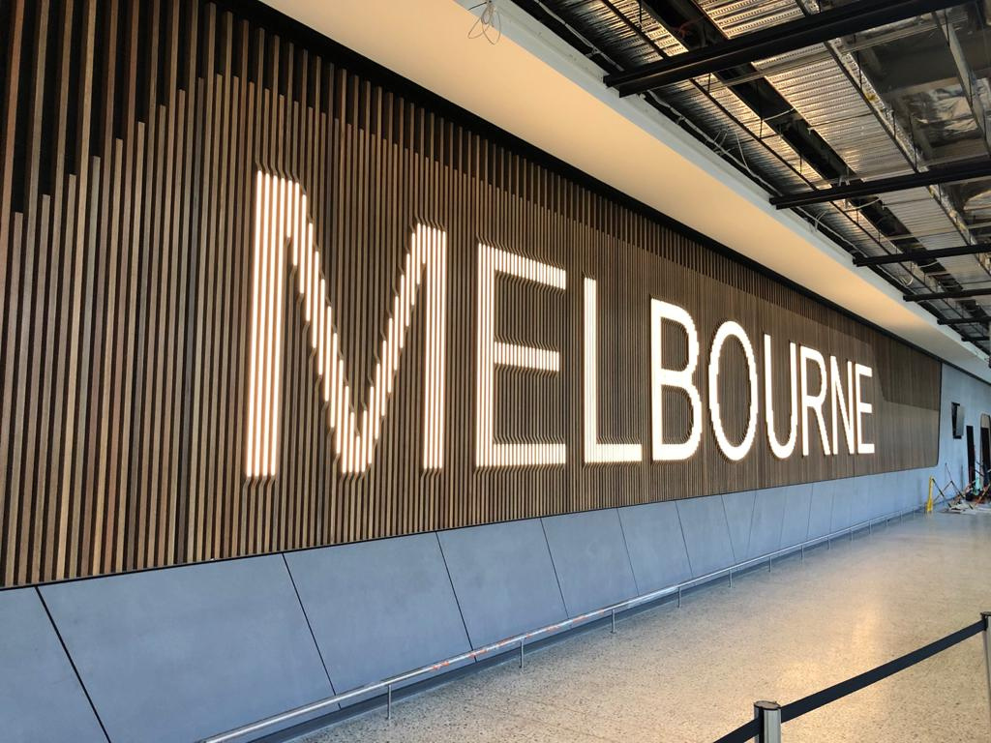
Summary
The Melbourne Airport Business Process Automation (BPA) Platform aims to revolutionize operational efficiency and decision-making through the strategic application of AI technologies. By incorporating advanced AI concepts and innovative features, the platform seeks to address the complex challenges faced by modern airports, ensuring seamless processes and enhanced customer experiences.

Slide 4

Objectives to Achieve
Efficiency
Decison Making
Automation
Integration
Scalability

Slide 5

Proposed Solutions
Solution # 1
Solution # 5
Communication and Collaboration Module
Melbo the Chatbot
Solution # 2
Solution # 6
Airside Safety Inspection
Sustainable Goals
Solution # 3
Optimizing Staff Management
Solution # 4
Live Incident Management

Slide 6
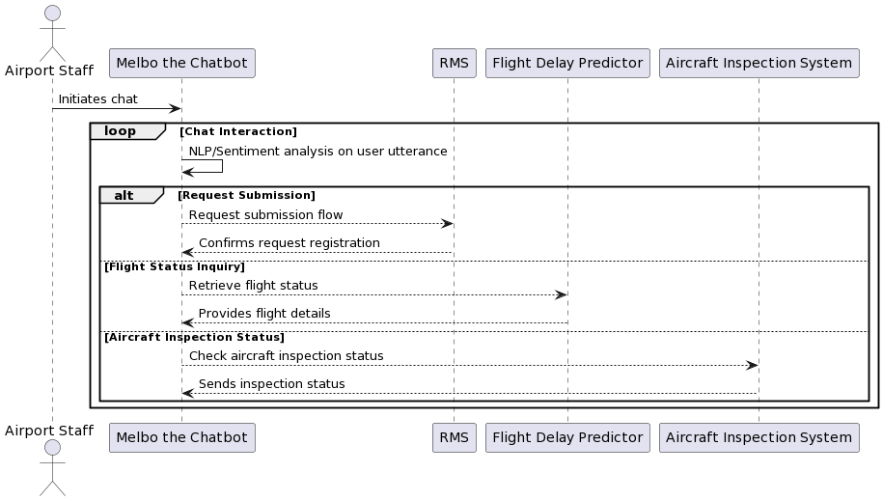
Communication and Collaboration Module
1 | The Communication and Collaboration module of our platform includes the powerful Unified Messaging System (UMS) and Request Management System (RMS).
2 | With UMS, airport staff can seamlessly communicate with each other, fostering collaboration and enhancing operational efficiency.This innate feature enables real-time messaging, file sharing, and team collaboration, ensuring smooth communication across departments.
3 | Our robust Request Management System (RMS) empowers staff at Melbourne Airport to create and manage service, work, and HR requests seamlessly across various departments.
4 | With RMS, teams can streamline their workflows, ensuring efficient coordination and timely resolution of requests, ultimately enhancing overall operational effectiveness.
5 | It also doubles as a User Management System, managing user identities, access rights, and authentication for system security and Ensures secure access to RMS and other essential systems while maintaining user roles and permissions for operational integrity.

Slide 7
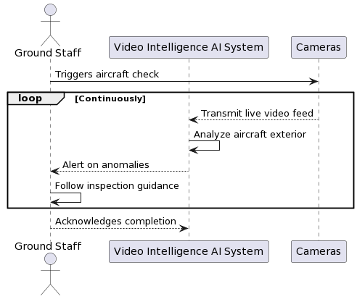
1 | Providing Integrated Video Intelligence by Utilizing Google's Video Intelligence AI API to continuously monitor aircraft conditions using camera sensors, ensuring real-time anomaly detection pre-flight and post-landing.
2 | Pre-Flight Anomaly Detection by Employing Google Vision API for precise anomaly detection, promptly alerting ground , allowing immediate corrective actions.
3 | Analyze post-flight video data with Google's Video Intelligence AI API and historical data from Kaggle, ensuring the integrity of aircraft instruments and external components. Provide prioritized inspection guidance to ground staff for thorough post-landing checks.
4 | Leverage Kaggle's historical data combined with AI algorithms Random Forest to train a prototype machine learning model tailored specifically to suggest or trigger the concerned team optimizing inspections.
5 | Offer real-time guidance to ground staff during inspections, ensuring compliance with safety protocols and accurate verification of aircraft integrity using Google tools and API like Google BigQuery and Google Cloud Vision API
Airside Safety Inspection

Slide 8
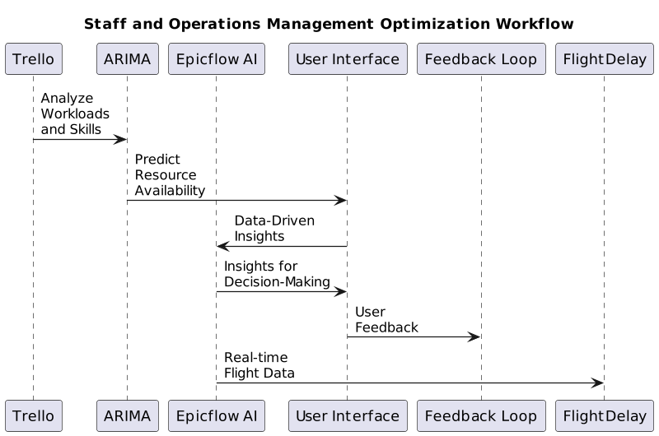
Optimizing Operation Management
1 | Automated Task Allocation and Workload Balancing tools (Trello) utilize AI algorithms to analyze historical data, current workloads, employee skills, and availability .
2 | Utilizing machine learning model ARIMA to predict resource availability and anticipate fluctuations in demand, enabling real-time adjustments to schedules.
3 | Enhance decision-making processes with data-driven insights by leveraging Epicflow AI to analyze both real-time and historical data. This approach offers valuable insights for strategic decision-making in staff management.
4 | Harnessing machine learning models like SciPy and Matplotlib to anticipate and mitigate flight delays, enhancing operational efficiency and passenger satisfaction.
5 | Establish a feedback loop to continuously monitor and improve the staff management optimization process. Provide regular assessments and updates to Deep Q-learning AI models based on user feedback and changing business needs in accordance with the monitoring results.

Slide 9
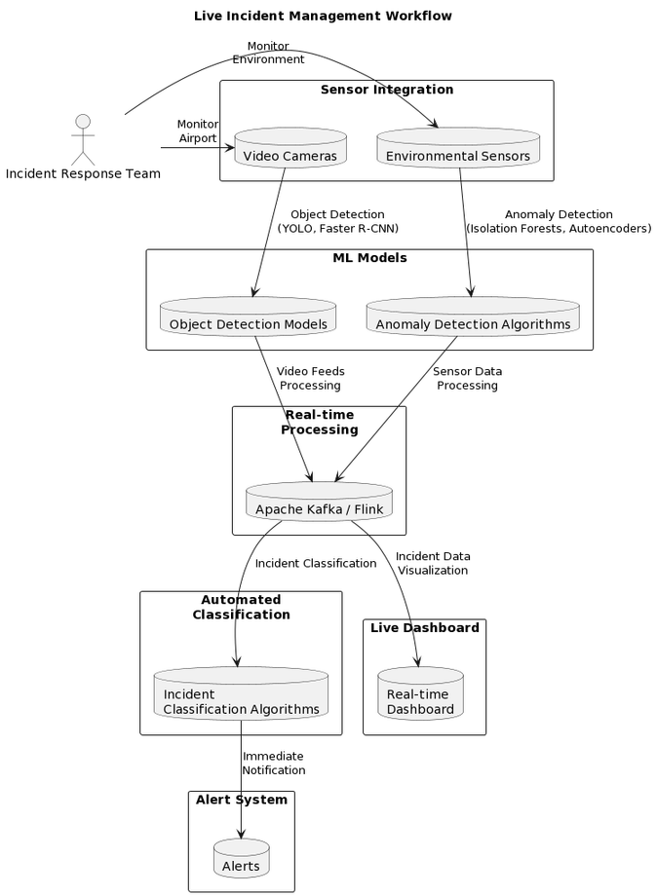
Live Incident Management
1 | For Automated Incident management, AI algorithms (YOLO, Faster R-CNN) swiftly detect and categorize incidents, ensuring a quick response by alarming the ground staff.
2 | Leveraging Apache Kafka or Flink optimizes real-time data processing, seamlessly incorporating inputs for efficient incident analysis.
3 | ELK stack automates alerts, contributing to overall operational efficiency and providing the staff instant alert.
4 | Enhanced Safety Measures with Drone Insights provides swift response to incidents, addressing security breaches and safety issues promptly.
5 | AI tools like Grafana aid proactive prevention, and continuous real-time processing ensuring operational continuity.

Slide 10
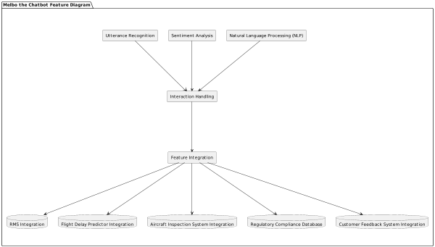
Melbo the Chatbot
1 | Continuously monitors incoming feedback uses NLP algorithm NLTK for text analysis to extract sentiments and key insights and apply algorithms like VADER to classify feedback sentiment and use LDA for issue identification.
2 | Integrated with Kore.ai, it streamlines request submissions to RMS. Staff engage via conversational interactions, simplifying the submission process and bypassing complex system navigation.
3 | Leveraging Kore.ai's NLP model, Melbo intelligently identifies user utterances and provides intelligent suggestions, data retrieval, and process guidance. This integration enhances operational efficiency and assists staff in making informed decisions.
4 | Operates as a centralized hub, integrated with UMS, enabling staff to access and interact with user details. It facilitates direct communication by redirecting to the User Management System, promoting seamless interaction and collaboration among staff members.
5 | Utilizing NLP of Kore.ai bot platform, Melbo assists senior employees in verifying regulatory compliance. Accessing databases or guidelines, it ensures proposed solutions align with aviation standards.
(customer feedback analysis)

Slide 11
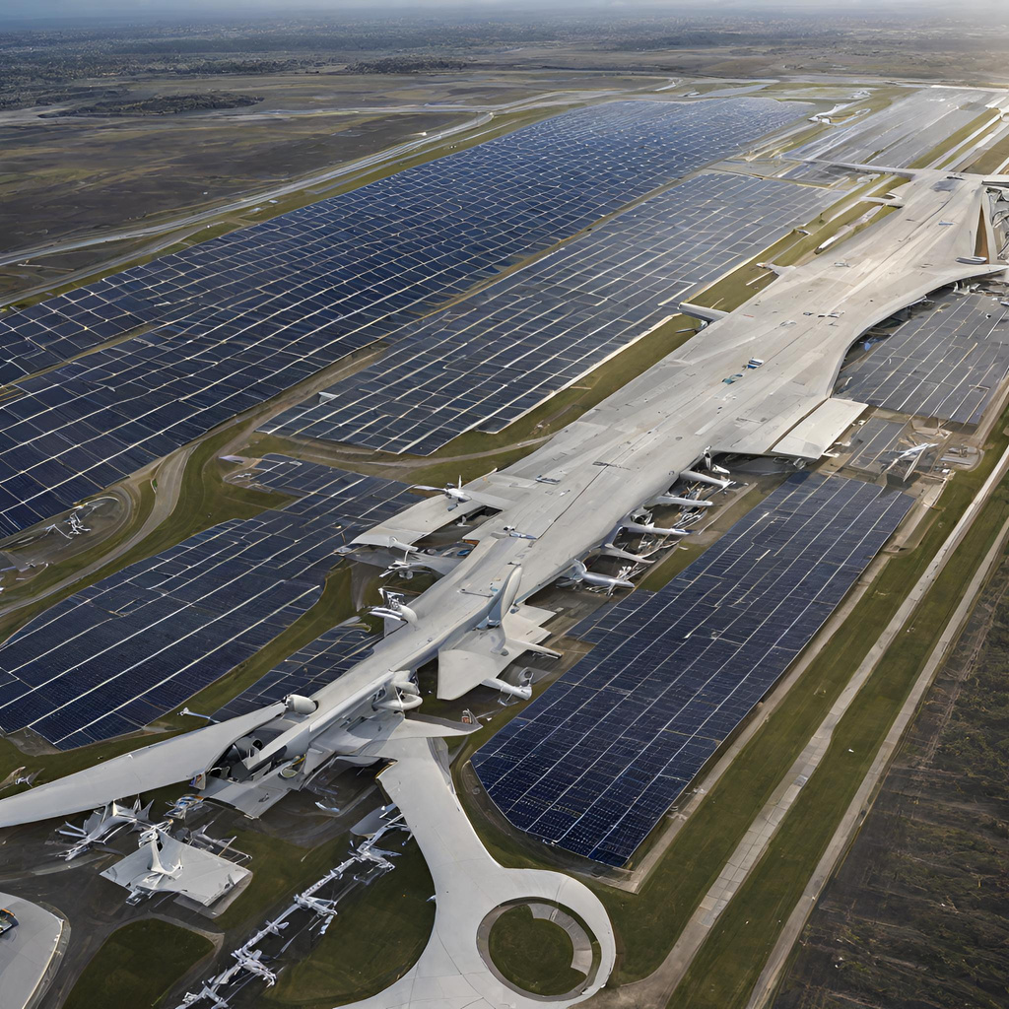
1 | By harnessing the power of AI and doing real-time monitoring, adaptive decision-making, and effective stakeholder engagement, the management can move beyond reactive measures and towards proactive strategies for mitigating PFAS risks and protecting human health and the environment.
2 | Based on APAC's Gas Heating Elimination Plan, The AI-powered Automation streamlines the implementation of gas efficiency measures, heat pump installations, and system optimizations.
3 | Automation supports the transition to electric vehicles seamlessly. The platform facilitates the deployment of electric charging infrastructure, optimizing the location and capacity based on AI-driven predictive models.
4 | The platform automates the integration of green building principles, ensuring that every capital project adheres to sustainability specifications.
5 | The AI-driven platform continually monitors and evaluates Melbourne Airport's carbon footprint, aligning with the Airport Carbon Accreditation program. Automation facilitates real-time tracking of emissions, including Scope 3 factors such as landing and take-off cycle emissions.
Sustainable Goals

Slide 12

System Architecture Overview
Understanding Workflow
Process Automation
Mapping out different departments and identifying tasks for automation and data-driven decision-making.
Implementing a unified platform for automating routine tasks leveraging AI and integrating case management.
FLOWCHART

Slide 13
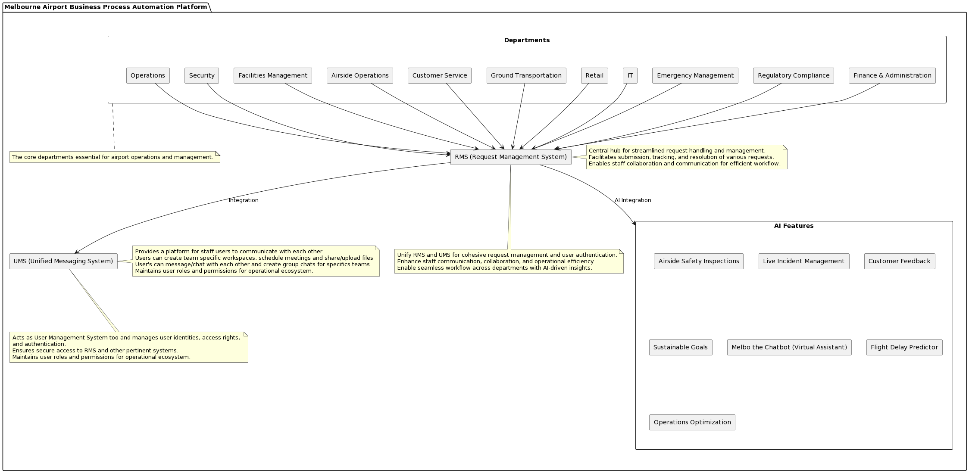

Slide 14
ThankYou
TEAM- MEDH.AI
LAKSHYA RAJ VIJAY
DHRUV YADAV
AKSH SAINI
SAI SUMEDH
+919785430457
+919971330386
+919811790406
+918919543387

